Slide 1
Determining Framework Requirements
Plan, Do, Check, Act – Security Controls
Lisa Niles, CISSP, Director of Solutions Integrations

Slide 2
Determining Framework Requirements
Am I doing the right things?
Notes:
We hear this all the time. Many CxO and architects, security teams all not 100% certain they are doing the right things…how do we validate…weed thru the endless reams of paper of requirements, are we interpreting them correctly…
Do we have the right tools, are they configured properly, what are we missing,

Slide 3
Is my ISP effective?
Do I have the right controls?
Plan:
Establish ISMS policy, objectives, processes and procedures relevant to managing risk and improving information security to deliver results in accordance with an organization’s overall policies and objectives.
Do:
Implement and operate the ISMS policy, controls, processes, and procedures.
Plan
Do
Check
Act
Information Security Program
Am I secure?
How do I measure progress?
Act:
Take corrective and preventive actions, based on the results of the internal ISMS audit and management review or other relevant information, to achieve continual improvement of the ISMS.
Check:
Assess and, where applicable, measure process performance against ISMS policy, objectives, and practical experience and report the results to management for review.
Notes:
You will be seeing this slide in our morning keynote Tuesday.
Our team is going to walk thru the basic PLAN, DO, CHECK, ACT approach to building your information security program.
This is a constantly evolving process as you mature thru your framework and achieve program maturity
We kick things off with PLAN- policy, objectives, process, procedure, governance.
We move to DO,,which will discuss here….the who, what, how, when, version of the program
Then CHECK,,,how do we assess our controls against stated policies and report
Then ACT…how do we take the results of the check and improve…then take that back to plan and start again/
Security controls are safeguards or countermeasures to avoid, detect, counteract, or minimize security risks to physical property, information, computer systems, or other assets.
They can be classified by several criteria. For example, according to the time that they act, relative to a security incident:
Before the event, preventive controls are intended to prevent an incident from occurring e.g. by locking out unauthorized intruders;
During the event, detective controls are intended to identify and characterize an incident in progress e.g. by sounding the intruder alarm and alerting the security guards or police;
After the event, corrective controls are intended to limit the extent of any damage caused by the incident e.g. by recovering the organization to normal working status as efficiently as possible.
According to their nature, for example:
Physical controls e.g. fences, doors, locks and fire extinguishers;
Procedural controls e.g. incident response processes, management oversight, security awareness and training;
Technical controls e.g. user authentication (login) and logical access controls, antivirus software, firewalls;
Legal and regulatory or compliance controls e.g. privacy laws, policies and clauses.
A similar categorization distinguishes control involving people, technology and operations/processes.
In the field of information security, such controls protect the confidentiality, integrity and/or availability of information - the so-called CIA Triad
Systems of controls can be referred to as frameworks or standards. Frameworks can enable an organization to manage security controls across different types of assets with consistency.

Slide 4
Determining Framework Requirements
Your first step select a security framework.
    NIST
    CIS
    ISO 27000-series
    Cobit
    HITRUST
    FFIEC
Notes:
Before we can determine the controls to implement we should select a controls frame work to help guide our plan
so start by 1st selecting a framework that will help us focus on the a prioritized list of controls and subcontrols (solution, process or procedures) that are rercommend for that framework
NIST, CIS, ISO, FFIEC, HITRUST are a few common frameworks you may already be using or have heard of.
Some frameworks may be better suited to your business objectives than others but they all have many very common controls.
Show cross reference xls)
Even if you do not have a framework that you follow…it is very easy to start
For instance…CIS is a great place to start
It’s a roadmap (a prioritized roadmap) for where to start
It provides a prioritized list with Actionable steps for implementation
CIS Maps to HIPAA, NIST, HITRUST, PCI so if you find in time another framework is needed efforts would not be lost
.
Your first step in determining the frameworks requirements is selecting a security framework.
The security framework formally describes the many processes, procedures and associated security controls that you can use to reduce risk across your organization and out to its many and diverse endpoints
COMMON SECURITY FRAMEWORKS
Commonly used security frameworks include the NIST Cybersecurity Framework, CIS Critical Security Controls, ISO 27000-series, ISA 99/IEC 62443, FFIEC Information Security, COBIT, COSO, and HITRUST CSF.The
PCI DSS, though mostly perceived as a compliance mandate, provides highly prescriptive security guidance that smaller and mid-size organizations in particular can leverage as a framework. and widely adopted in the US, defines five high-level functions of security: identify, protect, detect, respond and recover.It further defines 22 categories and 98 sub-categories within those functions.Similarly, the Center for Internet Security Critical Security Controls for Effective Cyber Defense (formerly known as the SANS Top 20 and the 20 Critical Security Controls), identifies 20 high-level critical security controls.Those 20 critical controls are categorized into families of ten System, four Network, and six Application controls, which are then further segmented into 149 total controls.
Each framework consists of high-level functions and detailed guidance on security controls .For example, the NIST Cybersecurity Framework, first published in 2014

Slide 5
Determining Framework Requirements
2nd Choose a maturity model
  Focuses on your security program’s implementation and management
  of security.
Notes:
CHOOSING A MATURITY MODEL
The second step involves choosing a maturity model, a valuable companion to your chosen security framework that focuses on your security program’s implementation and management of security
A maturity model specifies the types of processes and controls that should be in place as your security program advances through each stage of the model.
You’ll use your chosen model to assess and establish a baseline of the current state of your security program, and guide it toward achieving higher levels of security based on your chosen framework.
You can also use it to evaluate the effectiveness of your program and prioritize new investments.
COMMONLY USED MATURITY MODELS
Just as with security frameworks, you can select from a large number of maturity models. Your choice may be somewhat obvious depending on your selected framework, as many maturity models go hand-in-hand with a given framework.
For example, the Cybersecurity Capability Maturity Model (C2M2), produced by the US Department of Homeland Security in conjunction with the Department of Energy, complements the NIST Cybersecurity Framework.
The C2M2 model defines four levels of maturity with its maturity indicator levels, which range from 0–3 for each of the security domains covered by the NIST Cybersecurity Framework.
If you are a customer of Gartner, their IT Score for Information Security (www.gartner.com/doc/2507916/ itscore-information-security) is another option. This defines five maturity levels that range from Level 1: Initial to Level 5: Optimizing, along 10 measured dimensions.Forrester also offers its Information Security Maturity Model, with maturity levels that range from 0 – Non-existent to 5 – Optimized.
Show Auditscripts & RAM …

Slide 6
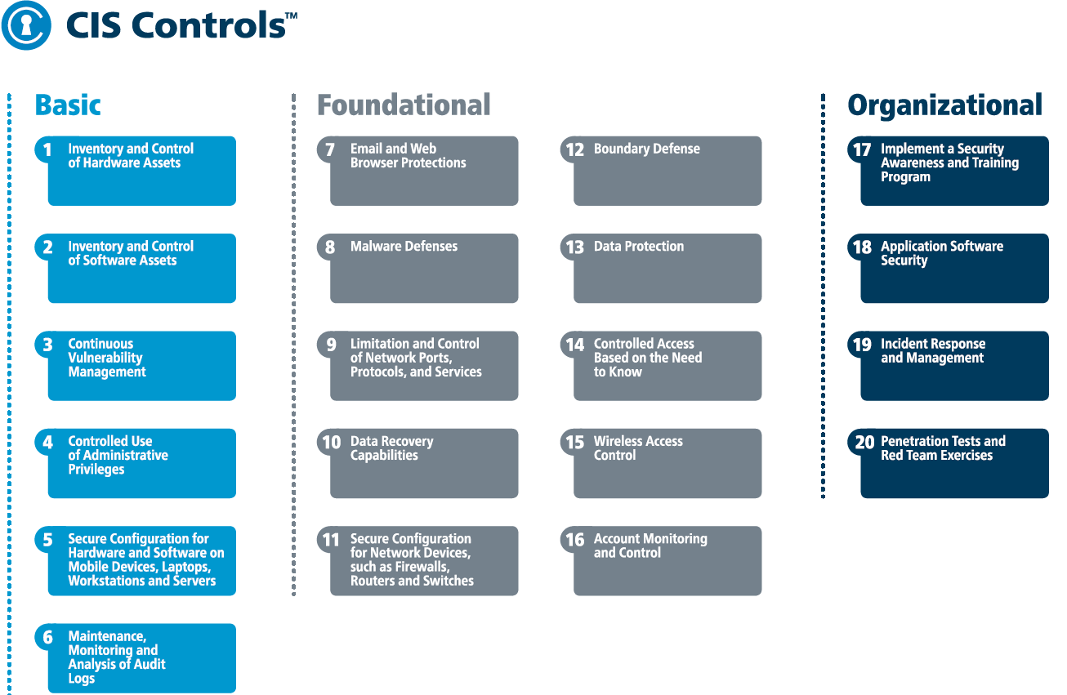
Determining Framework Requirements
Notes:
Here is the CIS TOP 20 Critical security controls
These are prioritized. The top 5 (now with version 7 released a few weeks ago…6 controls) are consider basic security hygiene and can provide 80% of your overall security functionality
I am sure most of you have a good portion of these already.
Lets look at the sub controls under each to better understand how a good framework is giving you your security roadmap,
**Show CIS xls.**

Slide 7
CIS Top 20 Controls List
Controls: | Controls:
Active Device Discovery System | Endpoint Protection System
Passive Device Discovery System | Host Based Firewall
Log Management System / SIEM | Application Aware Firewall
Asset Inventory System | Backup / Recovery System
Network Level Authentication (NLA) | Network Device Management System
Public Key Infrastructure (PKI) | Network Packet Capture System
Software Application Inventory | Network Based Intrusion Detection System (NIDS)
Software Whitelisting System | Network Based Intrusion Prevention System (IPS)
Network Firewall / Access Control System | Data Inventory / Classification System
SCAP Based Vulnerability Management System | Network Based Data Loss Prevention (DLP) System
Patch Management System | Whole Disk Encryption System
Privileged Account Management System | Host Based Data Loss Prevention (DLP) System
Multi-Factor Authentication System | Wireless Intrusion Detection System (WIDS)
Dedicated Administration Systems | Identity & Access Management System
System Configuration Baselines & Images | Training / Awareness Education Plans
System Configuration Enforcement System | Secure Coding Standards
Network Time Protocol (NTP) Systems | Software Vulnerability Scanning Tool
Network URL Filtering System | Web Application Firewall (WAF)
DNS Domain Filtering System | Incident Management Plans
Anti-Spam Gateway | Penetration Testing Plans
Notes:
Based on the desired end architecture (Planned maturity model for the framework)…your gap assessment will help determine where change is needed….now you actually start focusing on the controls…
Start off by Inventory Your Current Security Technologies, Hardware, Software-----do gap assessments to determine needs based on framework & maturity models
Do you have any of the following?
Firewall, to keep unauthorized users off your network
Virtual private network (VPN), to give employees, customers, and partners secure access to your network
Intrusion prevention, to detect and stop threats before they harm your network
Content security, to protect your network from viruses, spam, spyware, and other attacks
Secure wireless network, to provide safe network access to visitors and employees on the go
Identity management, to give you control over who and what can access the network
Then take the time to really understand the capabilities of these controls..this is a area I think many miss..….this is where working with you account team and our architects can really help you. We understand which controls can help at different areas of a framework…many time 1 controls can actually help you with 5, 6, 7 other controls and subcontrols…or even with latest versions of code can now support additional functionality toward your security framework.

Slide 8
Determining Framework Requirements
International information security standards
ISO/IEC 27001 specifies 114 controls in 14 groups:
A.5: Information security policies
A.6: How information security is organised
A.7: Human resources security - controls that are applied before, during, or after employment.
A.8: Asset management
A.9: Access controls and managing user access
A.10: Cryptographic technology
A.11: Physical security of the organisation's sites and equipment
A.12: Operational security
A.13: Secure communications and data transfer
A.14: Secure acquisition, development, and support of information systems
A.15: Security for suppliers and third parties
A.16: Incident management
A.17: Business continuity/disaster recovery (to the extent that it affects information security)
A.18: Compliance - with internal requirements, such as policies, and with external requirements, such as laws.

Slide 9
Determining Framework Requirements
From NIST Special Publication SP 800-53 revision 4.
AC Access Control.
AT Awareness and Training.
AU Audit and Accountability.
CA Security Assessment and Authorization. (historical abbreviation)
CM Configuration Management.
CP Contingency Planning.
IA Identification and Authentication.
IR Incident Response.
MA Maintenance.
MP Media Protection.
PE Physical and Environmental Protection.
PL Planning.
PS Personnel Security.
RA Risk Assessment.
SA System and Services Acquisition.
SC System and Communications Protection.
SI System and Information Integrity.
PM Program Management

Slide 10
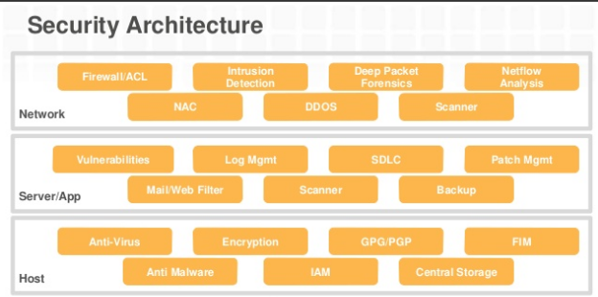
Determining Framework Requirements
Notes:
3rd develop a reference architecture . Based on where you want to be…this helps develop the roadmap to framework and maturity models.
The network infrastructure is perhaps the most critical technical asset of any organization. A good network architecture must meet performance and availability requirements, but it also must be secure. And, that security must be embedded into the network design. Enterprises continue to struggle with having visibility into, and securing, their complex infrastructures, while still maintaining network performance and availability
Based on the desired end architecture…your gap assessment will help determine where change is needed….now you actually start focusing on the controls…
How do you need to engineer the network? Zero trust, deeper segmentation…segment by business unit or app?
This is a view at pretty basic segments….by looking at all the controls at each level…..some thought may be into…how could I put this all inline?
Many points of failure…that in its self is a risk…or I add redundancy which adds complexity and cost ….If I need visibility and control into the same data flow….maybe the architecture would be best to use a tap…lets say I need to feed the same traffic flow to a firewall, ips, decryption, send to syslog, behavior analysis tool, threat engine, etc….maybe I copy the data and forward 1 stream to 5, 6, 7, controls and not inline, I can actually right size the platform to real data flow needs and not interface speeds and feeds…example a 1 G firewall vs 10G because of the physical interface…..also, what if someone DOS the firewall and it reboots…well I cannot log while rebooting…but if there was a tap…all data is seen and forwarded and you could capture the intended dos so a hacker should exploit a vulnerability during a reboot…not with a tap….so you can see that enterprise architecture very much plays into the overall security program.

Slide 11
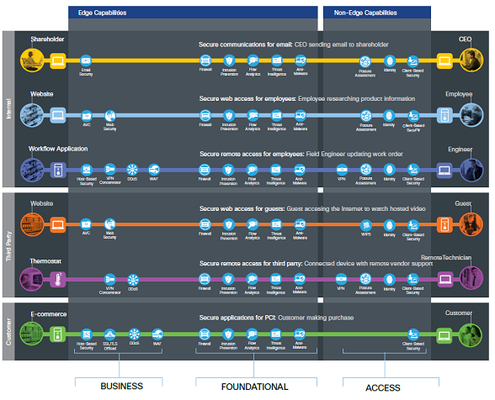
Determining Framework Requirements
Notes:
Or…. Look at business flows to determine the architecture and where to apply the needed controls
Functional controls are common security considerations that are derived from the technical aspects of the business flows.
Secure Applications require sufficient security controls for protection.
Secure Access Employees, third parties, customers, and devices securely accessing the network.
Secure Remote Access for employees and third-party partners that are external to the company network.
Secure Communications Email, voice, and video communications connect to potential threats outside of company control and must be secured.
Secure Web Access controls enforce usage policy and help prevent network infection.
Secure web access for employees: Employee researching product information

Slide 12
Determining Framework Requirements
4th Select the security solution vendors, and prioritize investments for the best results.
Notes:
4th Select the security solution vendors, and prioritize investments for the best results.
This may be one of the toughest. The decisions on which solution that match my frameworks requirements, maturity model, cost and operational factors all play in.
Also the what/who to believe. This is where a trusted advisor can save time and money.
We can help you plan, design, implement and validate you security controls.
In fact there are several solutions that cover 5, 6, 7 of the framework control objects …with 1 solution.

Slide 13
Determining Framework Requirements
Q&A?

Slide 14
Thank you!!

